Slide 1
Improving Productivity with Best Practices
Software Test and Performance
April 2007, San Mateo, CA
Tim Ngo
Notes:
Preface by saying this is a lot of information. For additional elaboration, stop by and talk at booth.

Slide 2
Agenda
Why Should We Have this Discussion Today?
Best Practices that Have Proven to be Successful
Strategies in Deploying These Best Practices

Slide 3
Quality and financial impact
NIST study in 2002 found that:
  Software bugs are costing US industry ~$60B/year
  60,000,000,000
  Users incur 64% of cost, developers 36%
  Improvements in testing could reduce this cost by about a third, or $22.5 billion
Shortest development schedules are correlated with high-quality software (target 95% defect-free code)

Slide 4
What is the development time spent on?
Specification – 40%
Actual coding – 10%
Testing – 50%

Slide 5
General Observations on Software Testing
Mostly focuses on functional testing, tied back to requirements
Design -> Code -> Integrate and Test
Testing efforts are focused on the isolation and fixing of “bugs” (error detection)

Slide 6
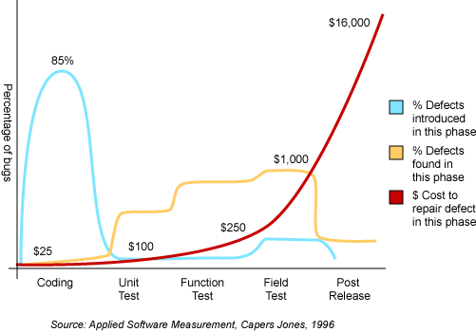
What Can We Do About the Cost of Bugs?
Simple Testing Problem: Error Prevention
Interface / Application Layer
Complex Testing Problem: Error Detection
Implementation Layer

Slide 7
“Quality comes not from inspection, but from
improvement of the development process.”
- W. Edward Deming
“ An ounce of prevention is worth a pound of cure.”
- Benjamin Franklin

Slide 8
Best Practices to Prevent Errors
Automated builds
Automated static analysis
  Coding standards
  Complexity analysis
  Dataflow analysis
  Code Reviews
Automated testing
  Unit testing
  Functional testing
  Regression testing

Slide 9
Automated Builds
Provides early detection of incompatible changes
Ensures that application continues to run as expected
Detects any defects introduced by newly integrated code

Slide 10
Automated Builds - General Guidelines
Create a special build account
Clean the build area before each build
Shadow or clone source code to the build directory
Build application at regularly scheduled intervals
Automate build process

Slide 11
Automated Builds - General Guidelines
Create hierarchies for build files
Parameterize scripts and build files
For n-tier applications, also create a build on a staging area
Fully integrate automated builds with source control
Integrate testing into build process

Slide 12
Automated Builds - Collect Results
Files and modules that passed compilation
Files and modules that failed compilation
Files that contain warnings and/or are incomplete during build for selected day
Number of builds in a day

Slide 13
Automated Testing - Static Analysis
Quickly find possible bugs and “gotchas”
Enforce application-specific guidelines
Enforce security policy
Improve readable and maintainable code
Find Errors On the Cheap!

Slide 14
Automated Testing - Static Analysis
Static analysis isn’t just for fixing formatting errors!
public void execute() throws SQLException {
Connection con = getConnection();
try {
// assume the connection is created here
Statement stmt = con.createStatement();
// ....
} catch(SQLException e) {
e.printStackTrace();
}
}
finally {
if (con != null && !con.isClosed()) {
con.close(); // FIXED
}

Slide 15
Automated Testing - Static Analysis
Set Quality Criteria
Detect Errors Based Off of Quality Criteria
Find and Fix the Root Cause
Implement Preventative Practices
Monitor the Process
Establish a feedback loop. Fix not only individual bugs, but improve overall process!
Notes:
- Create feedback loop
- This approach not only fixes specific bugs, but provides a mechanism for improving overall development process

Slide 16
Code Reviews
Born as Fagan inspections at IBM in 80’s
Known as one of the best techniques to catch bugs (also see Barry Boehm)
Generally suffer from inconsistencies, lack of follow-up, and high degree of induced boredom:
Lack of consistent coding policies (“gut review”)
Review time is spent mostly on validating conformance with coding policy, not algorithm/architecture/reuse
Issues are not recorded
Resolution of code review issues not tracked
Hard to perform with distributed teams

Slide 17
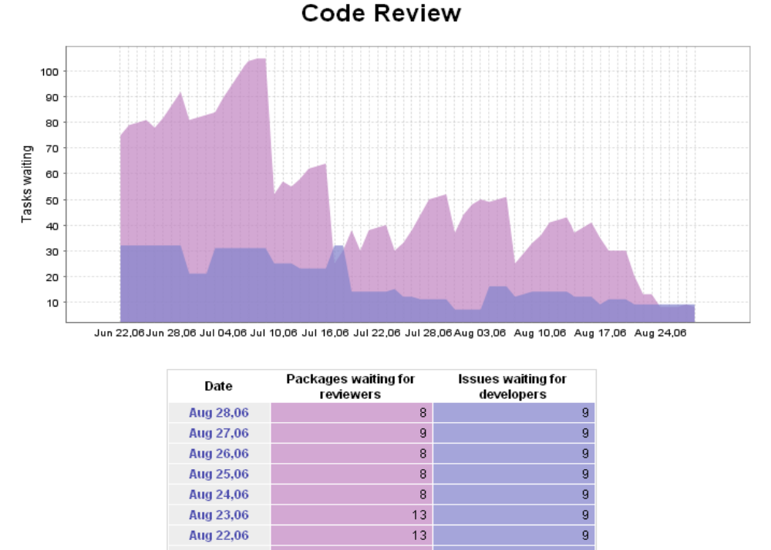
Code Reviews

Slide 18
Automated Testing - Unit Testing
Code can be tested before application is complete
Simpler to set up due to smaller state space
Simplify testing of error and exception handling at the function level
Reproducible
Can be shared among developers
Can be run as regression

Slide 19
Automation of Unit testing
Test generation
Test case management
Test execution / regressions
Report generation
Stubs generation / management / switching
Coverage analysis
Source control

Slide 20
Why Automation is Important!
Code reviews are time-intensive and human-intensive
  Review process can be streamlined by using a static analysis tool
Quality focus is typically NOT built into product schedules so there is typically little time to do proper testing.
  Automation is required to leverage these precious cycles
Developers write more testing procedures/code than the code they are developing for delivery!
  automates” much of the driver, stubs and infrastructure creation as well as provide metrics – ex: code coverage
Developers typically do NOT like testing.
  Some problems will never be solved!

Slide 21
Automated - Regression Test Suites
Why is it important?
  Development organizations need to ensure that code additions and changes do not break the previous verified functionally
  Provides a safety net for code changes and refactoring
What is required?
  All existing reliability and functionality tests should be regression tested on each new build of the application.
Simplifying the job
  Automated or continuous regression test suite
  Short feedback loop to developers
  Partition failure reports based on authorship of code or tests

Slide 22
Effective Adoption of Best Practices
Establish infrastructure
Apply general industry best practices
Implement custom best practices
Measurement and tracking of project status
Automation of repetitive tasks
Incremental adoption

Slide 23
Establish Infrastructure
Infrastructure includes:
  People
    Project Managers
    Architects/Test Engineers
    Software Developers
  Technology
    IDEs
    Source Control System
    Automated Build System
    Problem Tracking System

Slide 24
Apply General Industry Best Practices
Scott Meyers’ Effective C++ and More Effective C++
Sutter and Alexandrescu C++ Coding Standards
Ellemtel standards
Dan Saks “C/C++ Gotchas” series
Stephen Dewhurst “C++ Gotchas”
Portability (32 to 64 bits)
MISRA (including 2004)

Slide 25
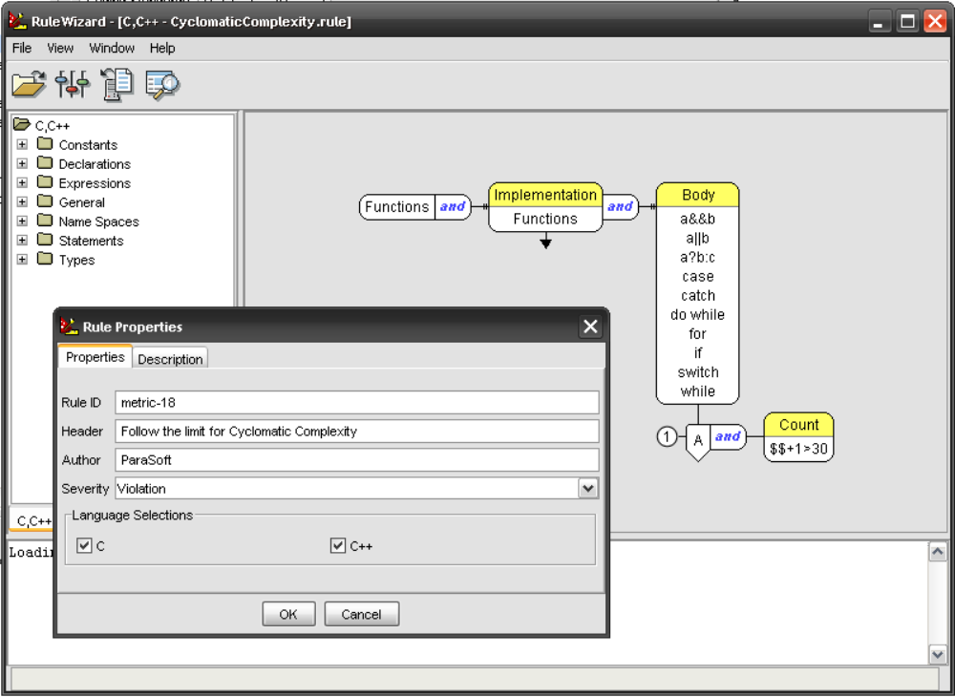
Implement Custom Best Practices

Slide 26
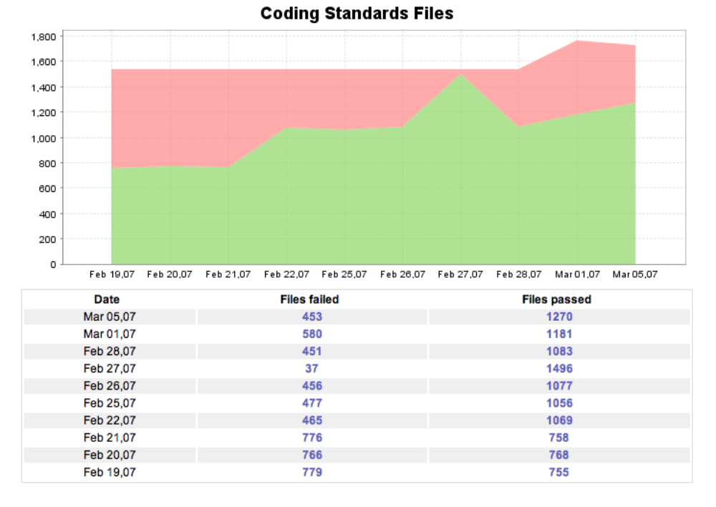
Measurement and Tracking of Status

Slide 27
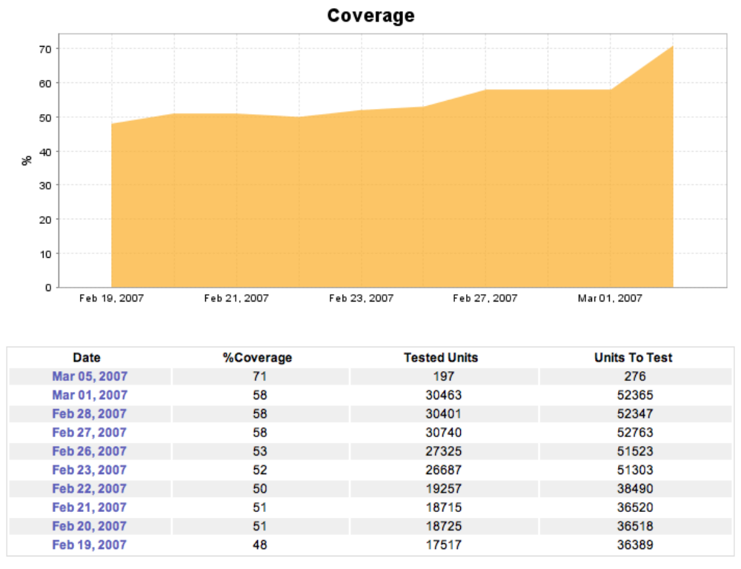
Measurement and Tracking of Status
Notes:
Code Coverage from SOAtest 5.0

Slide 28
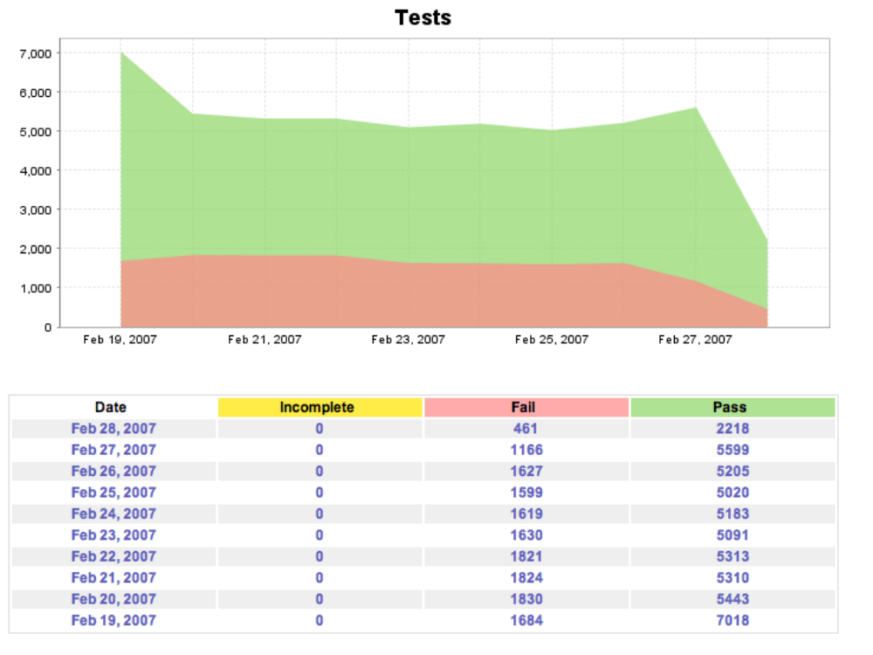
Measurement and Tracking of Status

Slide 29
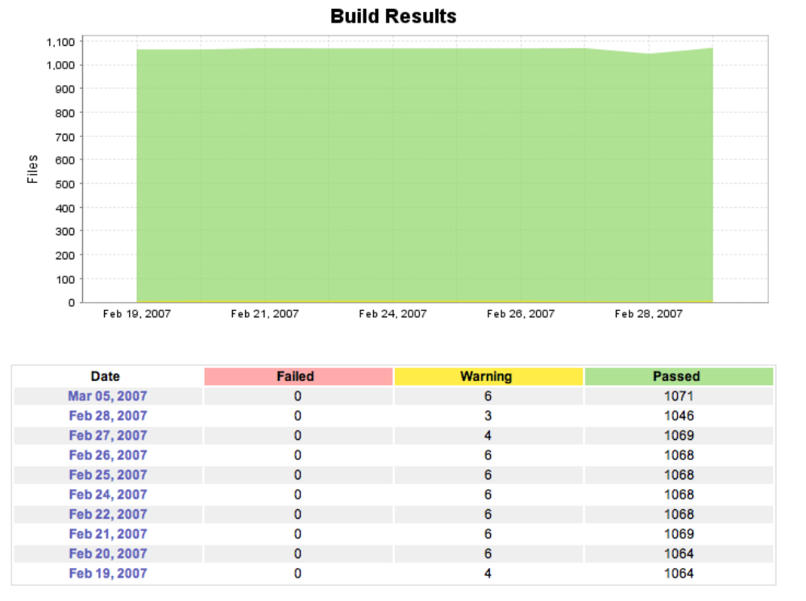
Measurement and Tracking of Status

Slide 30
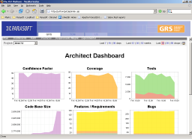

Automation of Repetitive Tasks
code & tests
SCM
Source Control
Developer
Machines
Batch Mode
Analysis
Test Results
Scheduled Test
Server
Analytical
Dashboard
Program Manager
Architect
Professional Editions
Nightly
Results
Architect /
Technical lead
TCM
Team Configuration
Manager
Architect Edition
Team Coding
Standards

Slide 31
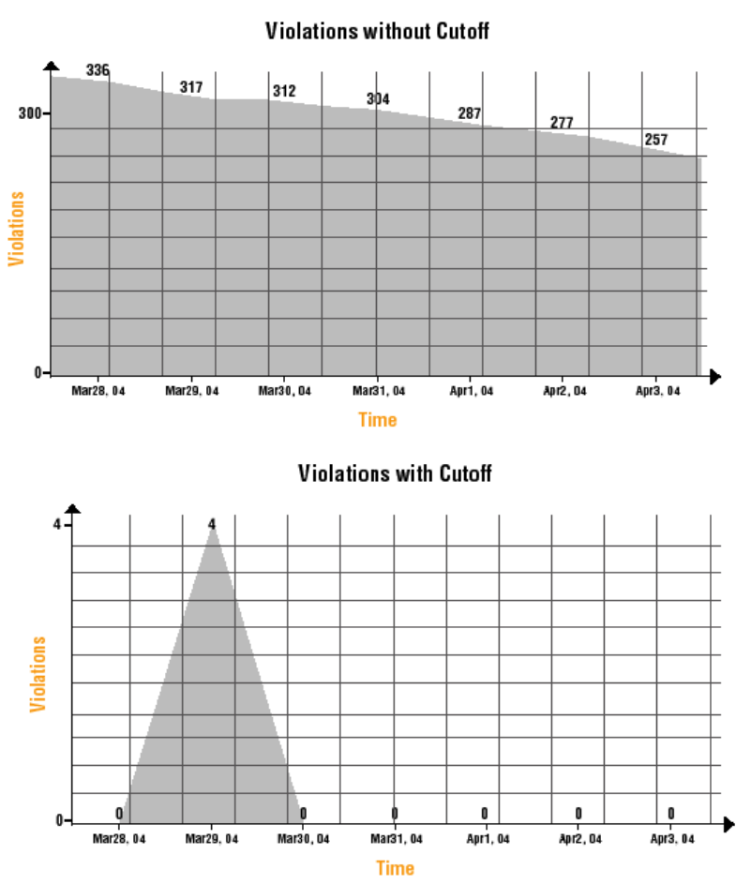
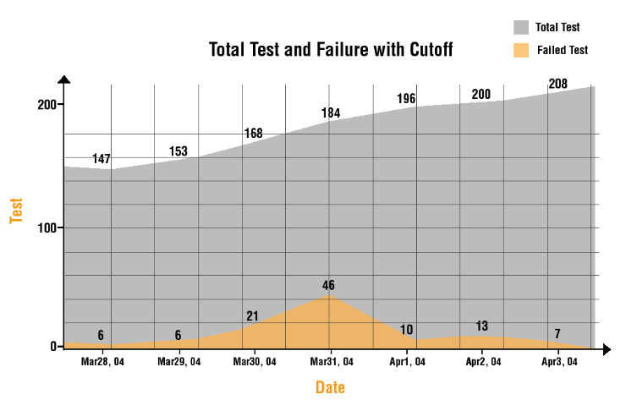
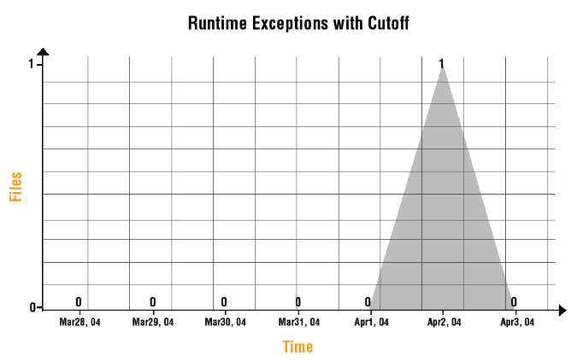
Incremental Adoption

Slide 32
Summary
Best practices result in higher productivity without added strain
Automation is key to success of best practices:
  Repeatability
  Consistency
  No bias
  Can be done in off-hours
Tools help greatly, but they are not the end in itself
Measure, control, and improve process

Slide 33
Questions?
Tim Ngo
tngo@parasoft.com

